Slide 1
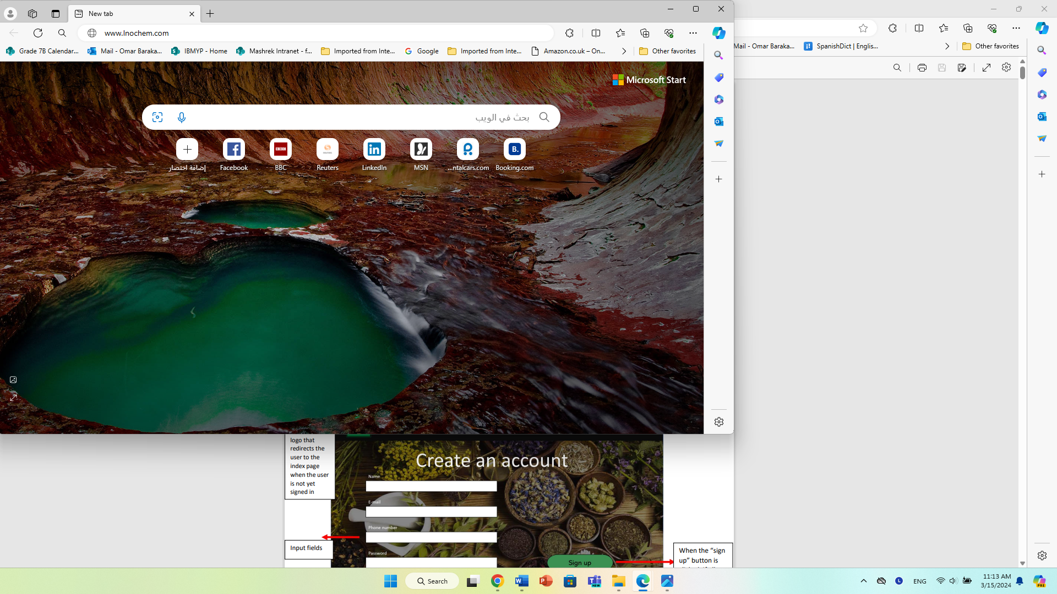



About Us
Search
Sign In
Sign Up
Welcome To
Inochem
Description

Slide 2

About Us
Search
Sign In
Sign Up
Create an account
Name
E-mail
Phone number
Password
Sign Up
Already have an account? Log in
Re-enter Password

Slide 3

About Us
Search
Sign In
Sign Up
About Us

Slide 4

About Us
Search
Sign In
Sign Up
Sign In
Admin Log In
Email
log In
Password
log in
Don’t have an account? Create an account

Slide 5



Our Products
Search
Log Out
Home
Description
Start Shopping
Inochem
-
+123-123456789
-
Inochem@Outlook.com

Slide 6
Our Products
Search
Log Out
Account Info
Name: George Johnson
Email: George.johnson@mail.com
Phone number: 1234567890
Change password
Inochem
-
+123-123456789
-
Inochem@Outlook.com

Slide 7
Our Products
Search
Log Out
Change password
Old password
New Password
Re-enter new Password
Confirm
Inochem
-
+123-123456789
-
Inochem@Outlook.com

Slide 8



Our Products
Search
Log Out
Chemical 1
Chemical 2
$9.99 per pound
$12.99 per pound
Description of chemical
Description of chemical
Add to cart
Add to cart
Chemical 3
Chemical 4
$7.99 per pound
$5.99 per pound
Description of chemical
Description of chemical
Add to cart
Add to cart
More
Inochem
-
+123-123456789
-
Inochem@Outlook.com

Slide 9

Our Products
Search
Log Out
My Cart
Total
Chemical 1
Quantity (pounds)
Total
$30.97
$9.99 per pound
1
$30.97
Chemical 2
Quantity (pounds)
$12.99 per pound
1
Checkout
Chemical 3
Quantity (pounds)
$7.99 per pound
1
Inochem
-
+123-123456789
-
Inochem@Outlook.com

Slide 10

Our Products
Search
Log Out
Enter you payment details
Card number
MM / YY CVC
Street address
Checkout
Country
City
State
Zip code
Inochem
-
+123-123456789
-
Inochem@Outlook.com

Slide 11
Our Products
Search
Log Out
Thank You For Your Purchase
Please expect a call from us soon
ETA: 5 days
Inochem
-
+123-123456789
-
Inochem@Outlook.com

Slide 12

Admin Log In
Name
Continue
Password

Slide 13
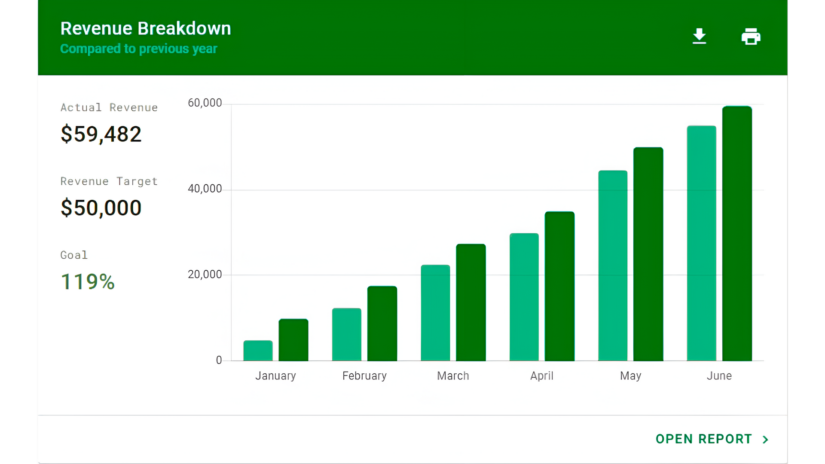
Admin accounts
user accounts
orders
Inventory
Log Out

Slide 14
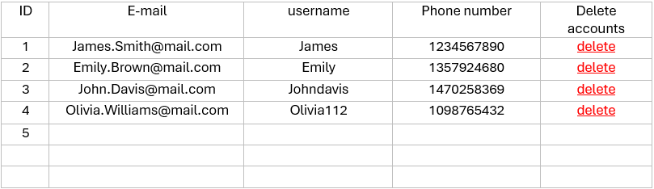
Admin accounts
user accounts
orders
Inventory
Log Out
Admin’s accounts
Create new admin account

Slide 15
Admin accounts
user accounts
orders
Inventory
Log Out
Create a new admin account
Username
E-mail
Phone number
Password
Sign Up
Re-enter Password

Slide 16
Admin accounts
user accounts
orders
Inventory
Log Out
User Accounts

Slide 17

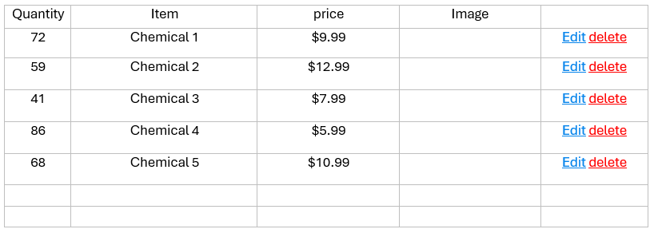

Admin accounts
user accounts
orders
Inventory
Log Out
Inventory
New inventory

Slide 18

Admin accounts
user accounts
orders
Inventory
Log Out
Create new inventory item
Item name
Item price
Item quantity
Submit Item
Description of item
Image of item
Upload a file
no file chosen

Slide 19

Admin accounts
user accounts
orders
Inventory
Log Out
Edit an inventory item
Item name
Chemical 1
Item price
$9.99
Item quantity
72
Description of item
description
Image of item
edit

Slide 20
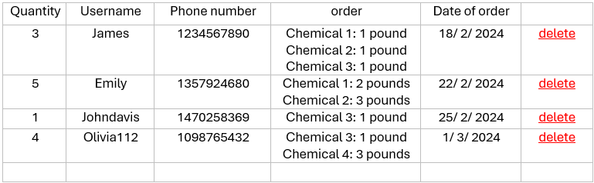
Admin accounts
user accounts
orders
Inventory
Log Out
Customer Orders

